Slide 1
A Complete Methodology of Data Modeling for MongoDB
San Francisco
Daniel Coupal
Education, MongoDB

Slide 2

Daniel Coupal
San Francisco
Senior Curriculum Engineer, Education, MongoDB
danielcoupal

Slide 3
Goals of the Presentation
Document vs Tabular
Methodology
Patterns
Recognize the differences
Summarize the steps when modeling for MongoDB
Recognize when to apply
Notes:
Topic is data modeling, more specifically data modeling for MongoDB
Talk is divided in three main topics
The first differences between modeling for document database versus a relational database
Introduce a methodology (simple to complex) , with steps to for MongoDB
Applying patterns, help you recognize
We will use real example

Slide 4
Goals of the Presentation
Document vs Tabular
Methodology
Patterns
Recognize the differences
Summarize the steps when modeling for MongoDB
Recognize when to apply
Notes:
Topic is data modeling, more specifically data modeling for MongoDB
Talk is divided in three main topics
The first differences between modeling for document database versus a relational database
Introduce a methodology (simple to complex) , with steps to for MongoDB
Applying patterns, help you recognize
We will use real example

Slide 5
Goals of the Presentation
Document vs Tabular
Methodology
Patterns
Recognize the differences
Summarize the steps when modeling for MongoDB
Recognize when to apply
Notes:
Topic is data modeling, more specifically data modeling for MongoDB
Talk is divided in three main topics
The first differences between modeling for document database versus a relational database
Introduce a methodology (simple to complex) , with steps to for MongoDB
Applying patterns, help you recognize
We will use real example

Slide 6
Document versus Tabular
Recognize the differences when modeling for a Document Database versus a Relational/Tabular Database

Slide 7
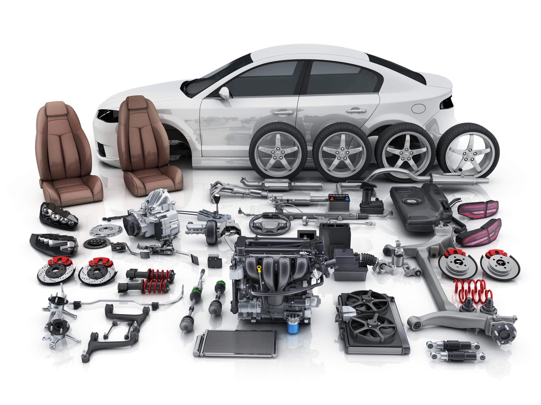
Car Stored in a Tabular/Relational Database
SELECT * FROM Cars
WHERE Cars.owner = "Daniel"
INNER JOIN Wheels Cars.id = Wheels.car_id
INNER JOIN Seats Cars.id = Seats.car_id
INNER JOIN Brakes Cars.id = Brakes.car_id
...

Slide 8
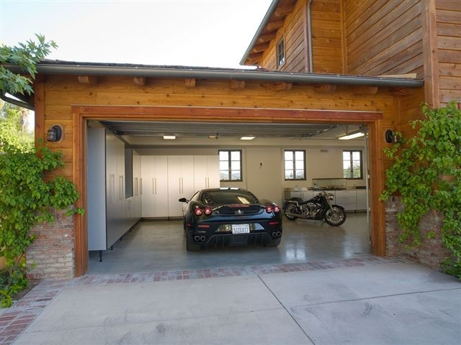
Car Stored in a Document Database
What goes together is stored together
db.cars.find( {"owner":"Daniel"} )

Slide 9
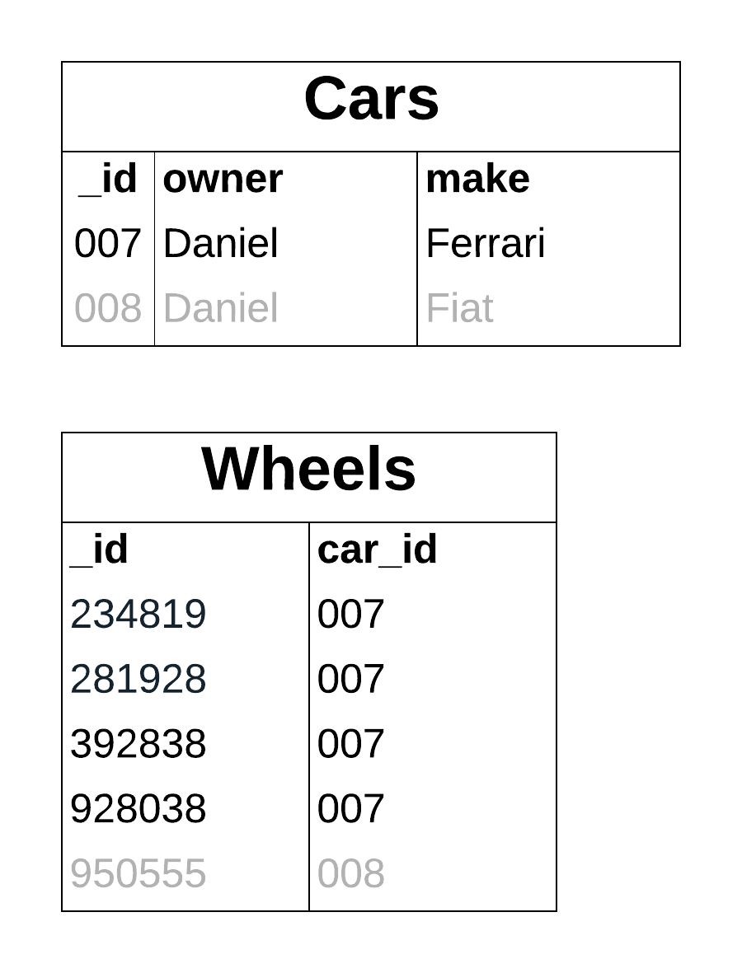
Arrays in the Document Model
Use to represents One-to-Many relationships

Slide 10
Arrays in the Document Model
Use to represents One-to-Many relationships
{
owner: "Daniel",
make: Ferrari,
wheels: [
partNo: 234812819289,
partNo:,
partNo: 392838,
partNo: 928038
],
...
}

Slide 11
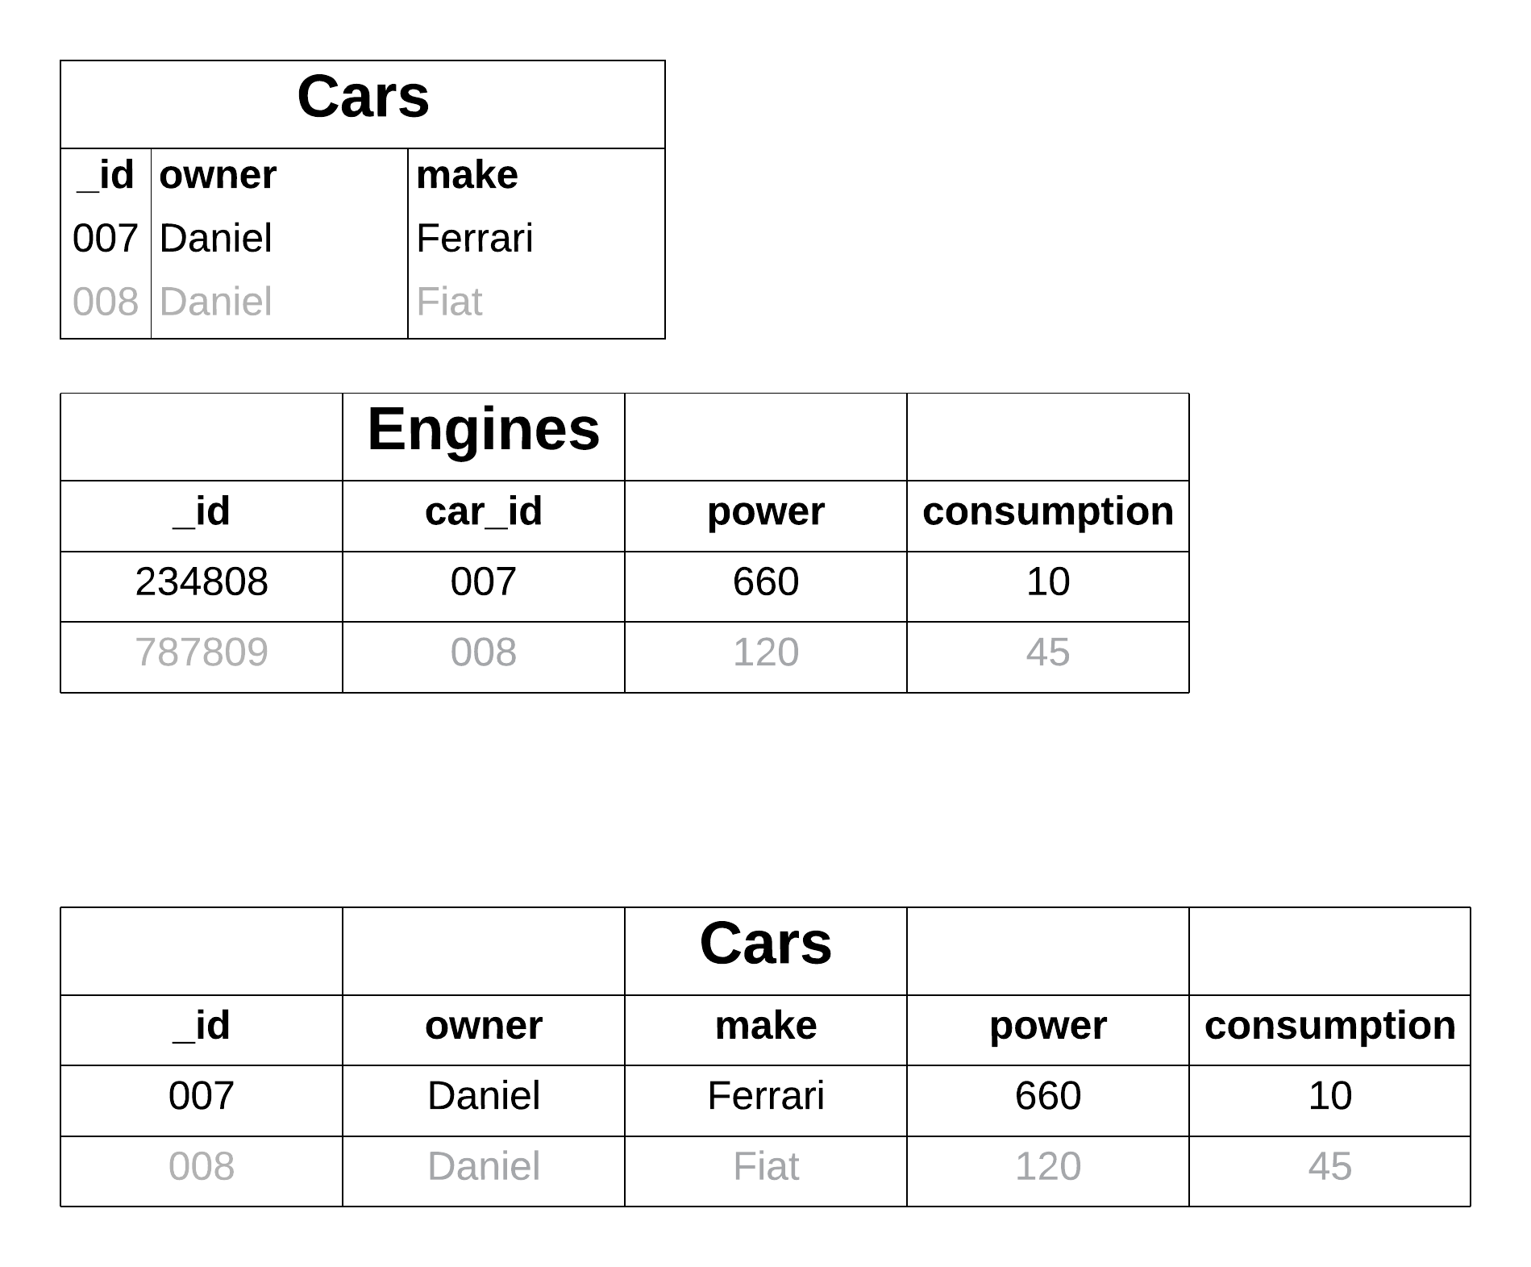
Sub-documents in the Document Model
Use to represents One-to-One relationships

Slide 12
Sub-documents in the Document Model
Use to represents One-to-One relationships
{
owner: "Daniel",
make: "Ferrari",
engine: {
power: 660hp,
consumption: 10mpg
}
…
}

Slide 13
Sub-documents in the Document Model
Use to represents One-to-One relationships
{
owner: "Daniel",
make: "Ferrari",
engine: {
power: 660hp,
consumption: 10mpg
}
…
}
db.cars.find(
{"owner":"Daniel"},
{"engine":1}
)
Projection

Slide 14
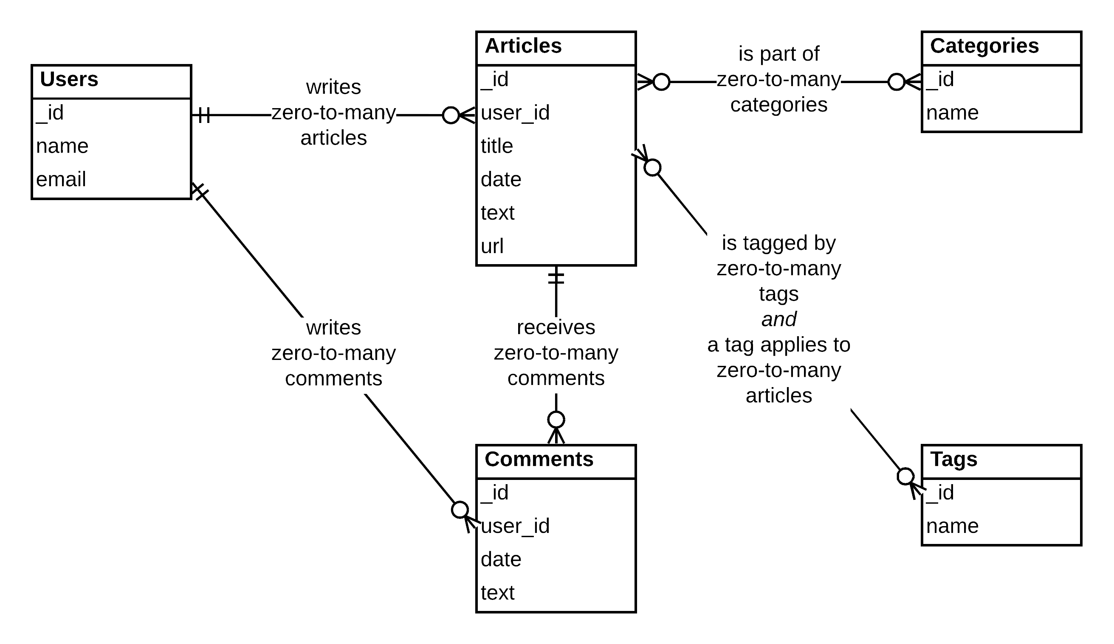
Example 1: Modeling a blog
Notes:
A little example: blog
In a relational database there is only one solution to represent a relationship between 2 fields. So your solution will look like this.
Briefly explain the few relationships in this sample
This is because in the schema is in third normal form.
In the third NF there are no 2 solution of this problem

Slide 15
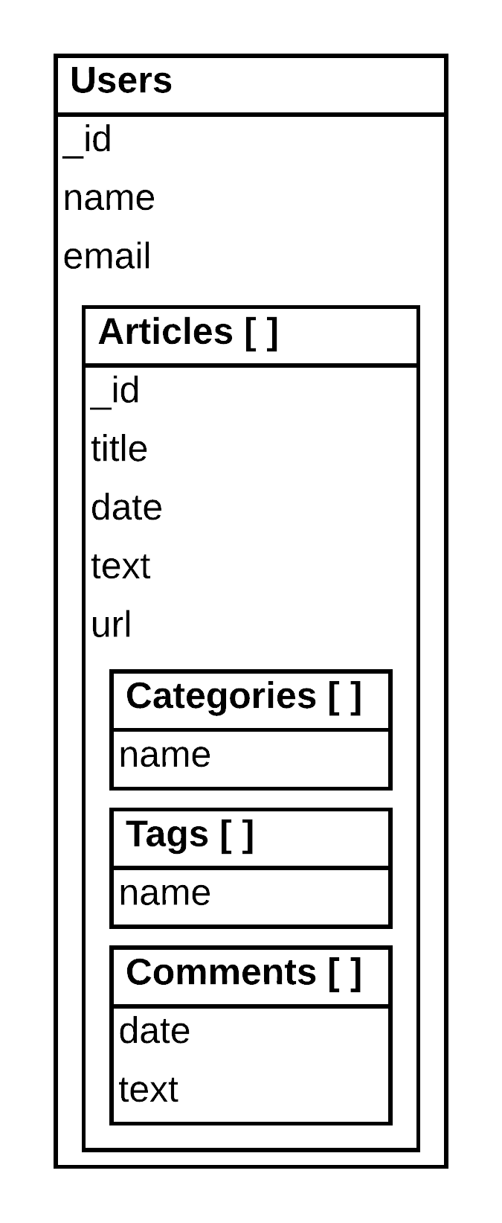
CRDs: A few Collection-Relationship-Diagrams Solutions
Solution A
Queries by users
Simple
Notes:
In MongoDB: There could be different solution!
Solution A: (everything is embedded)
Simpler
Oriented "articles"
Solution B: (keep the users separate)
A little more complex
Oriented 'articles' and 'users'
Avoid duplication of users
Which approach is better? Both can be valid.
The question is how are you going to use the data, what are the queries?

Slide 16
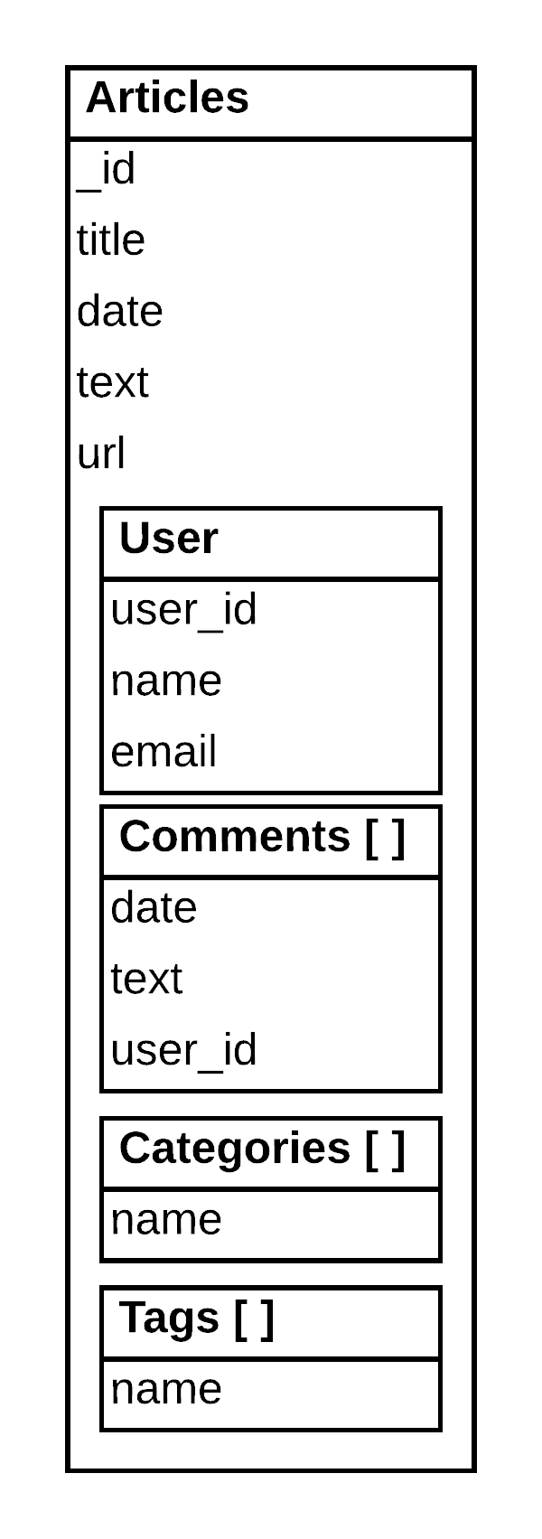
CRDs: A few Collection-Relationship-Diagrams Solutions
Solution A
Solution B
Queries by users
Queries by articles
Duplication of users information
Simple
Notes:
In MongoDB: There could be different solution!
Solution A: (everything is embedded)
Simpler
Oriented "articles"
Solution B: (keep the users separate)
A little more complex
Oriented 'articles' and 'users'
Avoid duplication of users
Which approach is better? Both can be valid.
The question is how are you going to use the data, what are the queries?

Slide 17
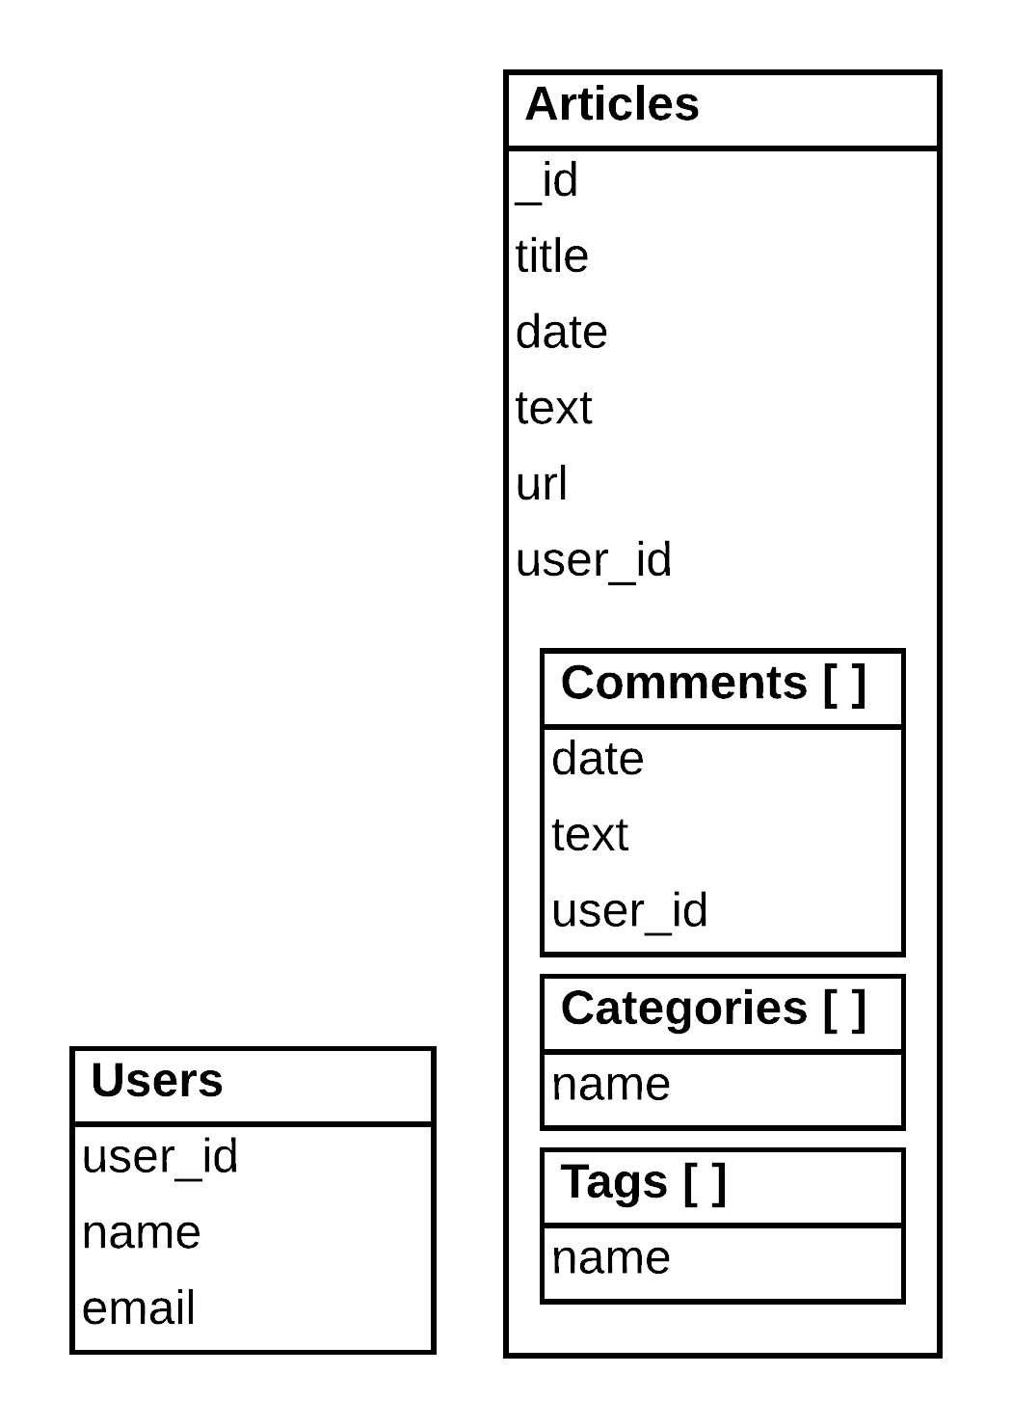
CRDs: A few Collection-Relationship-Diagrams Solutions
Solution A
Solution B
Solution C
Queries by users
Queries by articles
Duplication of users information
Simple
Notes:
In MongoDB: There could be different solution!
Solution A: (everything is embedded)
Simpler
Oriented "articles"
Solution B: (keep the users separate)
A little more complex
Oriented 'articles' and 'users'
Avoid duplication of users
Which approach is better? Both can be valid.
The question is how are you going to use the data, what are the queries?

Slide 18

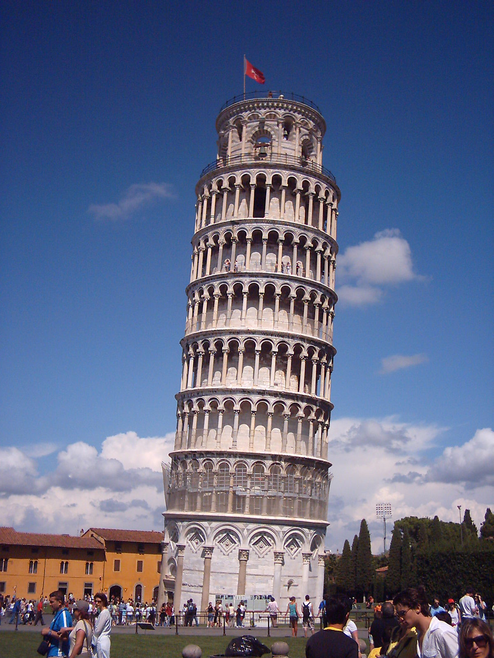



Example 2: Modeling a Social Network
Notes:
Another example: social network.
Solution A:
Write the new information, pictures, comments for a given user in his profile
When a user comes in and wants to see his profile, we need to read all the different assets, to construct his profile page.
Solution B:
Write the new information in each profile of the followers

Slide 19
Example 2: Modeling a Social Network
Solution A
write
read
Images Collection
Notes:
Another example: social network.
Solution A:
Write the new information, pictures, comments for a given user in his profile
When a user comes in and wants to see his profile, we need to read all the different assets, to construct his profile page.
Solution B:
Write the new information in each profile of the followers

Slide 20
Example 2: Modeling a Social Network
Solution B
write
read
Profiles Collection
Notes:
Another example: social network.
Solution A:
Write the new information, pictures, comments for a given user in his profile
When a user comes in and wants to see his profile, we need to read all the different assets, to construct his profile page.
Solution B:
Write the new information in each profile of the followers

Slide 21
Example 2: Modeling a Social Network
Solution B
write
read
Pre-aggregated Data
Slower writes
More storage space
Duplication
Faster reads
Profiles Collection
Notes:
Another example: social network.
Solution A:
Write the new information, pictures, comments for a given user in his profile
When a user comes in and wants to see his profile, we need to read all the different assets, to construct his profile page.
Solution B:
Write the new information in each profile of the followers

Slide 22
Differences: Tabular vs Document
 | Tabular | MongoDB
Steps to create the model | 1 – define schema 2 – develop app and queries | 1 – identifying the queries 2 – define schema
Notes:
We also refer to a Relational Database as a Tabular Database.
Most important: what are the most important queries, that drive your design.
Side-by-side: model for tabular databases and MongoDB,
MongoDB: first steps of defining your model is identify most important queries.
In the relational world people tend to go in a room on white board the model by asking questions about the domain.
The result is an entity relationship diagram. From there they will develop solution.
Well, when you develop on MongoDB you should really reevaluate that you should really try to understand how your workloads are.
Then you write your schema.

Slide 23
Differences: Tabular vs Document
 | Tabular | MongoDB
Steps to create the model | 1 – define schema 2 – develop app and queries | 1 – identifying the queries 2 – define schema
Initial schema | 3rd normal form one possible solution | many possible solutions
Notes:
Relational database one solution! (because there is only one way to model relationship)
With MongoDB you have to deal with different possible solutions.

Slide 24
Differences: Tabular vs Document
 | Tabular | MongoDB
Steps to create the model | 1 – define schema 2 – develop app and queries | 1 – identifying the queries 2 – define schema
Initial schema | 3rd normal form one possible solution | many possible solutions
Final schema | likely denormalized | few changes
Notes:
The final scheme.
relational is likely to be denormalized,
Because of some performance issues,
Requires you to back in your code and figure out what is slow and identify those queries.
This is the beginning of some duplication or breaking some relationship.
As for MongoDB because you already thought about performance at the beginning of your design is likely to less changes to do.

Slide 25
Differences: Tabular vs Document
 | Tabular | MongoDB
Steps to create the model | 1 – define schema 2 – develop app and queries | 1 – identifying the queries 2 – define schema
Initial schema | 3rd normal form one possible solution | many possible solutions
Final schema | likely denormalized | few changes
Schema evolution | difficult and not optimal likely downtime | easy no downtime
Notes:
Lifecylce management on your schema:
Even if you to make a few changes, the good news is that with MongoDB it's easy to make changes to your schema.
Without downtime.
For tabular database schema changes very complex and might impact availability.

Slide 26
Differences: Tabular vs Document
 | Tabular | MongoDB
Steps to create the model | 1 – define schema 2 – develop app and queries | 1 – identifying the queries 2 – define schema
Initial schema | 3rd normal form one possible solution | many possible solutions
Final schema | likely denormalized | few changes
Schema evolution | difficult and not optimal likely downtime | easy no downtime
Performance | mediocre | optimized
Notes:
Optimize performance is complex if your read all over the place.
Identifying bottleneck is cumbersome and time consuming.
MongoDB when you do your model you probably want to group all the information that should go together in a single document so 1 read will bring everything in memory. Additionally, your documents will align better with the code structure. Eliminating mapping data to object in code

Slide 27
Methodology
Summarize the steps of a methodology when modeling for MongoDB

Slide 28
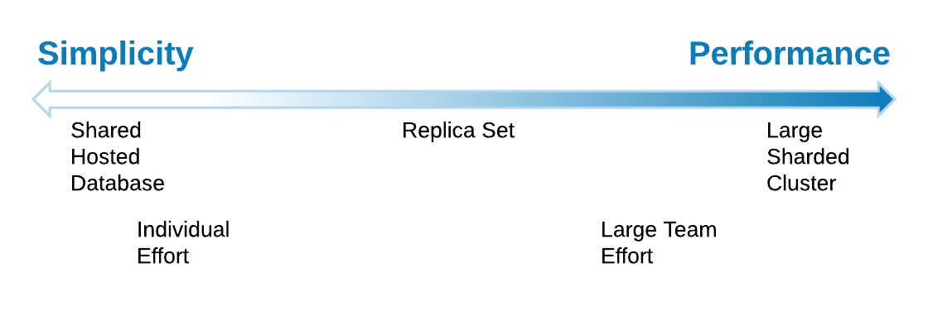
Main Tradeoff in Modeling
Notes:
When modelling decide for (you have to choose)
Simplicity:
- If Small team, or data set is small and is for sure a replicaset.
Performance.
- Working in a big team with data set that requires sharding
- Divide your artifacts to different team members,
- Enable working in parallel / more isolates parts of the model

Slide 29
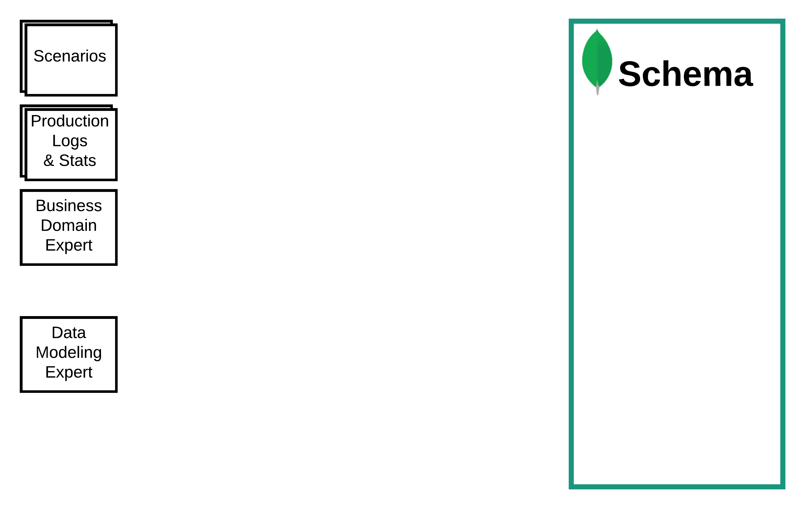
Methodology
Notes:
Different inputs available
Migrating from a RDBMS would provide logs and stats on the current system
May be there are documented scenarios
Or consult business Domain experts

Slide 30
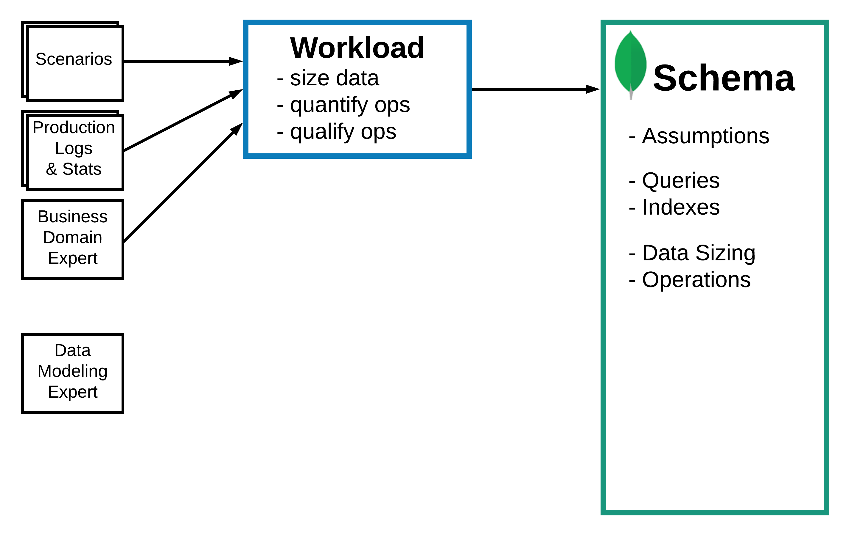
Methodology
Describe the Workload
Notes:
3 resources provide input to the "Workload" in terms of
Size_date
Number of operations
Quantify operations -> durability.
Outputs:
Queries on tdata
Potential Indexes
Size of data
Operation in terms of create/read/update and delete
Assumptions (important)
Assumptions change!?

Slide 31
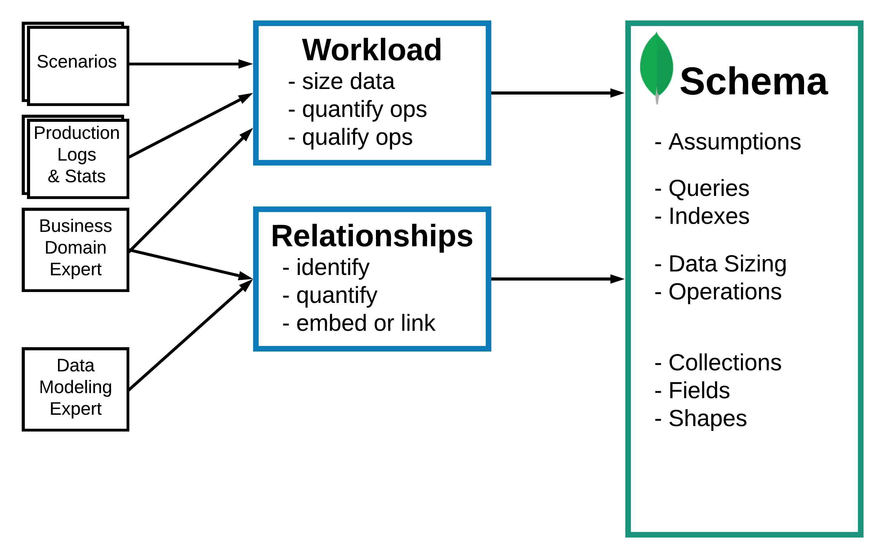
Methodology
Describe the Workload
Identify and Model the Relationships
Notes:
Athough MongoDB is a Document Store we do have relationship.
Here we need to consult
Data Modeling experts
Business Domain expert
The outputs:
Collections
Fields
Shapes (types, sub document, array)

Slide 32
Actors, Movies and Reviews
actor_name
date_of_birth
movie_title
revenues
reviewer_name
rating

Slide 33
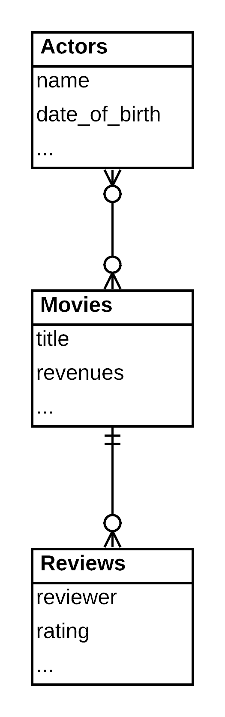
Actors, Movies and Reviews
actor_name
date_of_birth
movie_title
revenues
reviewer
rating

Slide 34
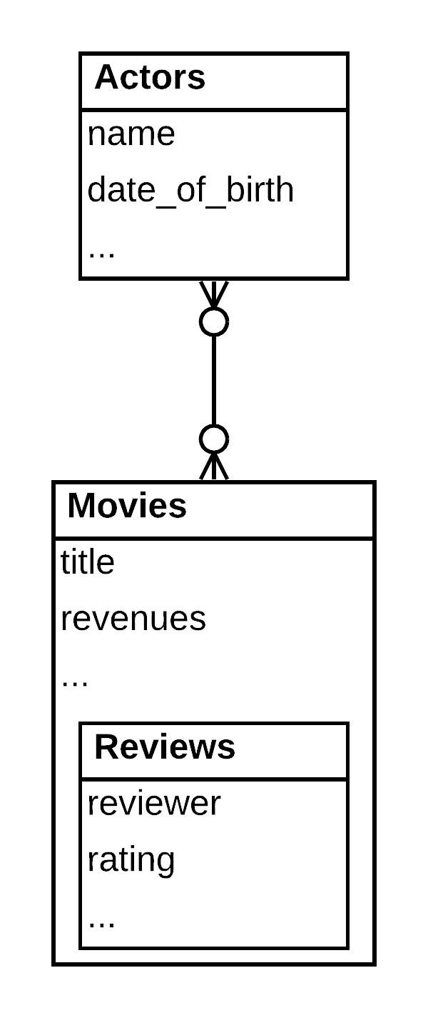
Actors, Movies and Reviews
actor_name
date_of_birth
movie_title
revenues
reviewer
rating

Slide 35
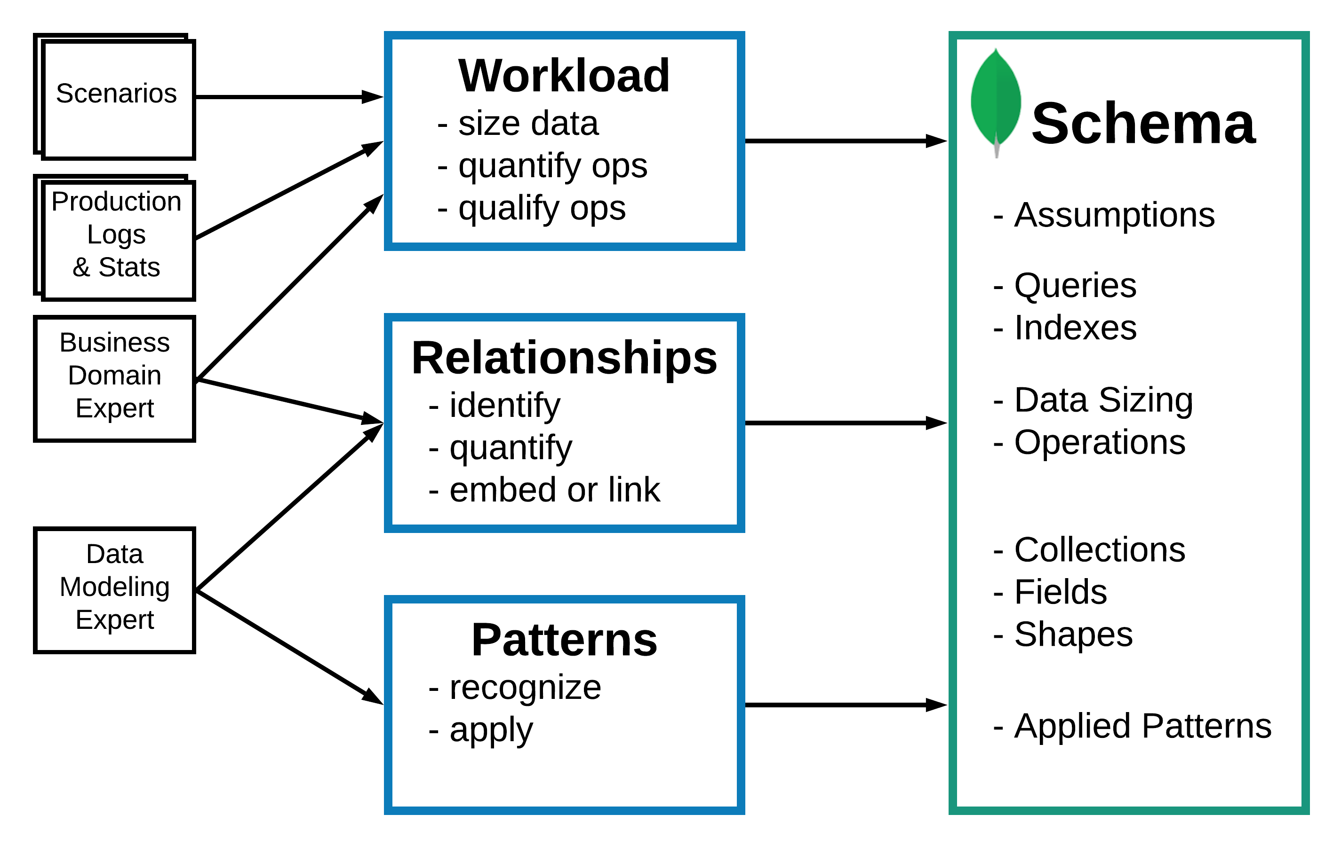
Methodology
Describe the Workload
Identify and Model the Relationships
Apply Patterns
Notes:
At the end of step 2. you have answered the important questions how to model each relationship
Should if be embedded
Or will it be linked
Step 3: is mostly around a lot of patterns on performance. You only need to apply them if they are needed
More on why we have patterns and we will come back to them.

Slide 36
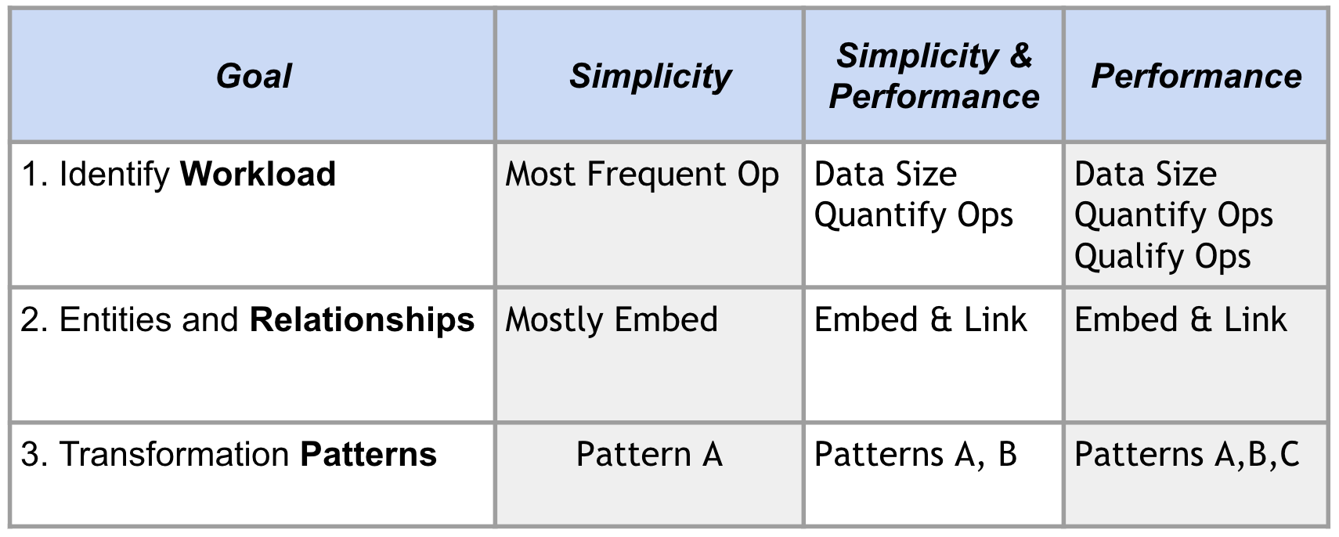
Flexible Methodology
Notes:
The methodology to your needs.
Decide if you can go for simplicity or that you have to go for performance
Then apply each of the appropriate steps.
For the workload, In case of simplicity,
identify the most freq operations
Mostly embed the relationship
And apply a few patterns
In case of Performance
For the workload you need to do a bit more: data size, quantify and qualify the operations
For relationship you will end up using embedding and linking
More patterns will be required

Slide 37
Use Case
Let's start a franchise of coffee shops…
Notes:
Let us take the methodology and apply to a use case.

Slide 38
Case Study: Coffee Shop Franchises
Name: Beyond the Stars Coffee

Slide 39
Case Study: Coffee Shop Franchises
Name: Beyond the Stars Coffee
Objective:
10 000 stores in North America

Slide 40
Case Study: Coffee Shop Franchises
Name: Beyond the Stars Coffee
Objective:
10 000 stores in North America
… then we expend to the rest of the World

Slide 41
Case Study: Coffee Shop Franchises
Name: Beyond the Stars Coffee
Objective:
10 000 stores in North America
… then we expand to the rest of the World
Keys to success:
Best coffee in the world

Slide 42
Case Study: Coffee Shop Franchises
Name: Beyond the Stars Coffee
Objective:
10 000 stores in North America
… then we expand to the rest of the World
Keys to success:
Best coffee in the world
Best Technology

Slide 43

First Key to Success: Make the Best Coffee in the World
23g of ground coffee in, 20g of extracted coffee out, in approximately 20 seconds
Fill a small or regular cup with 80% hot water (not boiling but pretty hot). Your cup should be 150ml to 200ml in total volume, 80% of which will be hot water.
Grind 23g of coffee into your portafilter using the double basket. We use a scale that you can get here.
Draw 20g of coffee over the hot water by placing your cup on a scale, press tare and extract your shot.

Slide 44
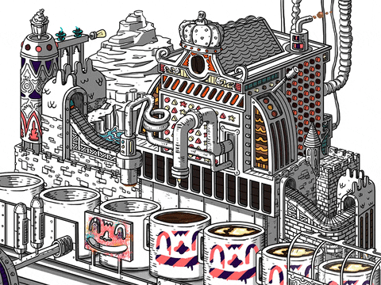
Second Key to Success: Use the Best Technology
Intelligent Coffee Machines
Weightings, temperature, time to produce, …
Coffee perfection

Slide 45

Key to Success 2: Best Technology
Intelligent Coffee Machines
Weightings, temperature, time to produce, …
Coffee perfection
Intelligent Shelves
Measure inventory in real time

Slide 46

Key to Success 2: Best Technology
Intelligent Coffee Machines
Weightings, temperature, time to produce, …
Coffee perfection
Intelligent Shelves
Measure inventory in real time
Intelligent Data Storage
MongoDB

Slide 47
Methodology
Describe the Workload
Identify and Model the Relationships
Apply Patterns

Slide 48
1 – Workload: List Queries
Query | Operation | Description
1. Coffee weight on the shelves | write | A shelf send information when coffee bags are added or removed

Slide 49
1 – Workload: List Queries
Query | Operation | Description
1. Coffee weight on the shelves | write | A shelf send information when coffee bags are added or removed
2. Coffee to deliver to stores | read | How much coffee do we have to ship to the store in the next days

Slide 50
1 – Workload: List Queries
Query | Operation | Description
1. Coffee weight on the shelves | write | A shelf send information when coffee bags are added or removed
2. Coffee to deliver to stores | read | How much coffee do we have to ship to the store in the next days
3. Anomalies in the inventory | read | Analytics

Slide 51
1 – Workload: List Queries
Query | Operation | Description
1. Coffee weight on the shelves | write | A shelf send information when coffee bags are added or removed
2. Coffee to deliver to stores | read | How much coffee do we have to ship to the store in the next days
3. Anomalies in the inventory | read | Analytics
4. Making a cup of coffee | write | A coffee machine reporting on the production of a coffee cup

Slide 52
1 – Workload: List Queries
Query | Operation | Description
1. Coffee weight on the shelves | write | A shelf send information when coffee bags are added or removed
2. Coffee to deliver to stores | read | How much coffee do we have to ship to the store in the next days
3. Anomalies in the inventory | read | Analytics
4. Making a cup of coffee | write | A coffee machine reporting on the production of a coffee cup
5. Analysis of cups of coffee | read | Analytics

Slide 53
1 – Workload: List Queries
Query | Operation | Description
1. Coffee weight on the shelves | write | A shelf send information when coffee bags are added or removed
2. Coffee to deliver to stores | read | How much coffee do we have to ship to the store in the next days
3. Anomalies in the inventory | read | Analytics
4. Making a cup of coffee | write | A coffee machine reporting on the production of a coffee cup
5. Analysis of cups of coffee | read | Analytics
6. Technical Support | read | Helping our franchisees

Slide 54
1 – Workload: quantify/qualify the queries
Query | Quantification | Qualification
1. Coffee weight on the shelves | 10/day*shelf*store => 1/sec | <1s critical write
2. Coffee to deliver to stores | 1/day*store => 0.1/sec | <60s
3. Anomalies in the inventory | 24 reads/day | <5mins "collection scan"
4. Making a cup of coffee | 10 000 000 writes/day 115 writes/sec | <100ms non-critical write
… cups of coffee at rush hour | 3 000 000 writes/hr 833 writes/sec | <100ms non-critical write
5. Analysis of cups of coffee | 24 reads/day | stale data is fine "collection scan"
6. Technical Support | 1000 reads/day | <1s
Notes:
If every time a bag cofffee is add or removed from the shelf, we will get an event.
10 bags / remove per day
1 shelf
10000 stores
Approx 1 write per second
4. Making a cup of coffee
1000 cups per store
10000 stores
= 10 mio writes per day
115 writes per second
But that is not evenly distributed so we have to be more specific
30% of all coffee brew is within one hour
We get 833 writes / sec
5. Analysis does not happen very often so we the number of reads is very low
QUALIFY,
impact on inventory! Write Majority, Collection scan impact in Workingset -> Analytics (Secondary)

Slide 55
1 – Workload: quantify/qualify the queries
Query | Quantification | Qualification
1. Coffee weight on the shelves | 10/day*shelf*store => 1/sec | <1s critical write
2. Coffee to deliver to stores | 1/day*store => 0.1/sec | <60s
3. Anomalies in the inventory | 24 reads/day | <5mins "collection scan"
4. Making a cup of coffee | 10 000 000 writes/day 115 writes/sec | <100ms non-critical write
… cups of coffee at rush hour | 3 000 000 writes/hr 833 writes/sec | <100ms non-critical write
5. Analysis of cups of coffee | 24 reads/day | stale data is fine "collection scan"
6. Technical Support | 1000 reads/day | <1s
Notes:
One query dwarfs the rest, this will help us provision the I/O.
And helps to confirm that we should use a single replicaset for this use case

Slide 56
Disk Space
Cups of coffee
Weighings
one year of data
10000 x 1000/day x 365
3.7 billions/year
370 GB (100 bytes/cup of coffee)
one year of data
10000 x 10/day x 365
365 billions/year
3.7 GB (100 bytes/weighings)
Notes:
One collection dwarfs the other one, this will help size the disks
Also tells us where we need to effort to optimize the datamodel.
It will also tell that "if data is kept for 10 years" (Changing Assumptions)
We then need to use a shared topology for MongoDB.

Slide 57
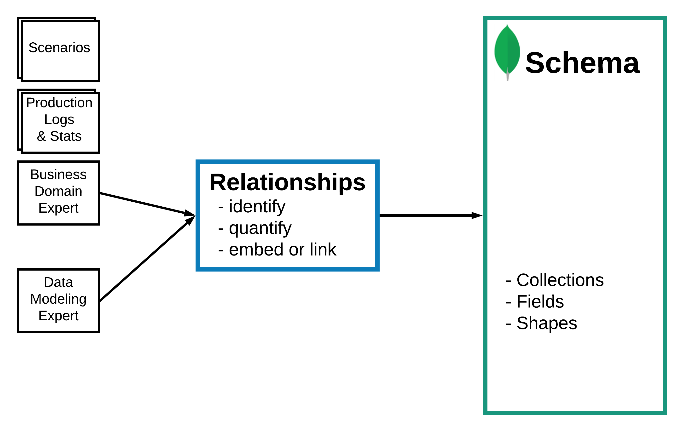
Methodology
Describe the Workload
Identify and Model the Relationships
Apply Patterns
Notes:
Review this step and explain why its important.

Slide 58
2 - Relations are still important
Type of Relation -> | one-to-one/1-1 | one-to-many/1-N | many-to-many/N-N
Document embedded in the parent document | one read no joins | one read no joins | one read no joins duplication of information
Document referenced in the parent document | smaller reads many reads | smaller reads many reads | smaller reads many reads
Notes:
We need to answer the magic question: should we embed or should we link.
one-to-one relationship?
or one-to-many?
or many-to-many
Smaller read = Smaller workingset
Is duplication manageable? Yes if there infrequent updates

Slide 59
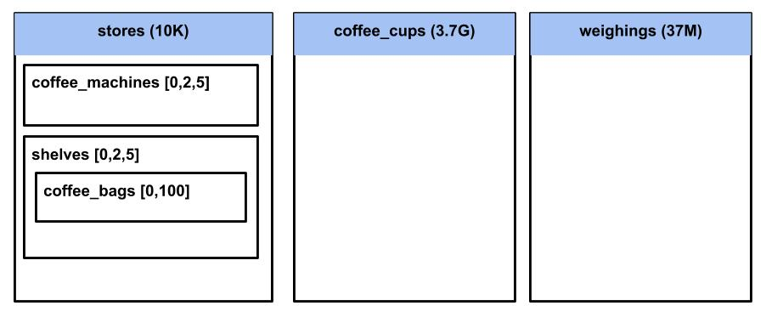
2 - Entities for Beyond the Stars Coffee
Entities:
Coffee cups
Stores
Coffee machines
Shelves
Weighings
Coffee bags

Slide 60
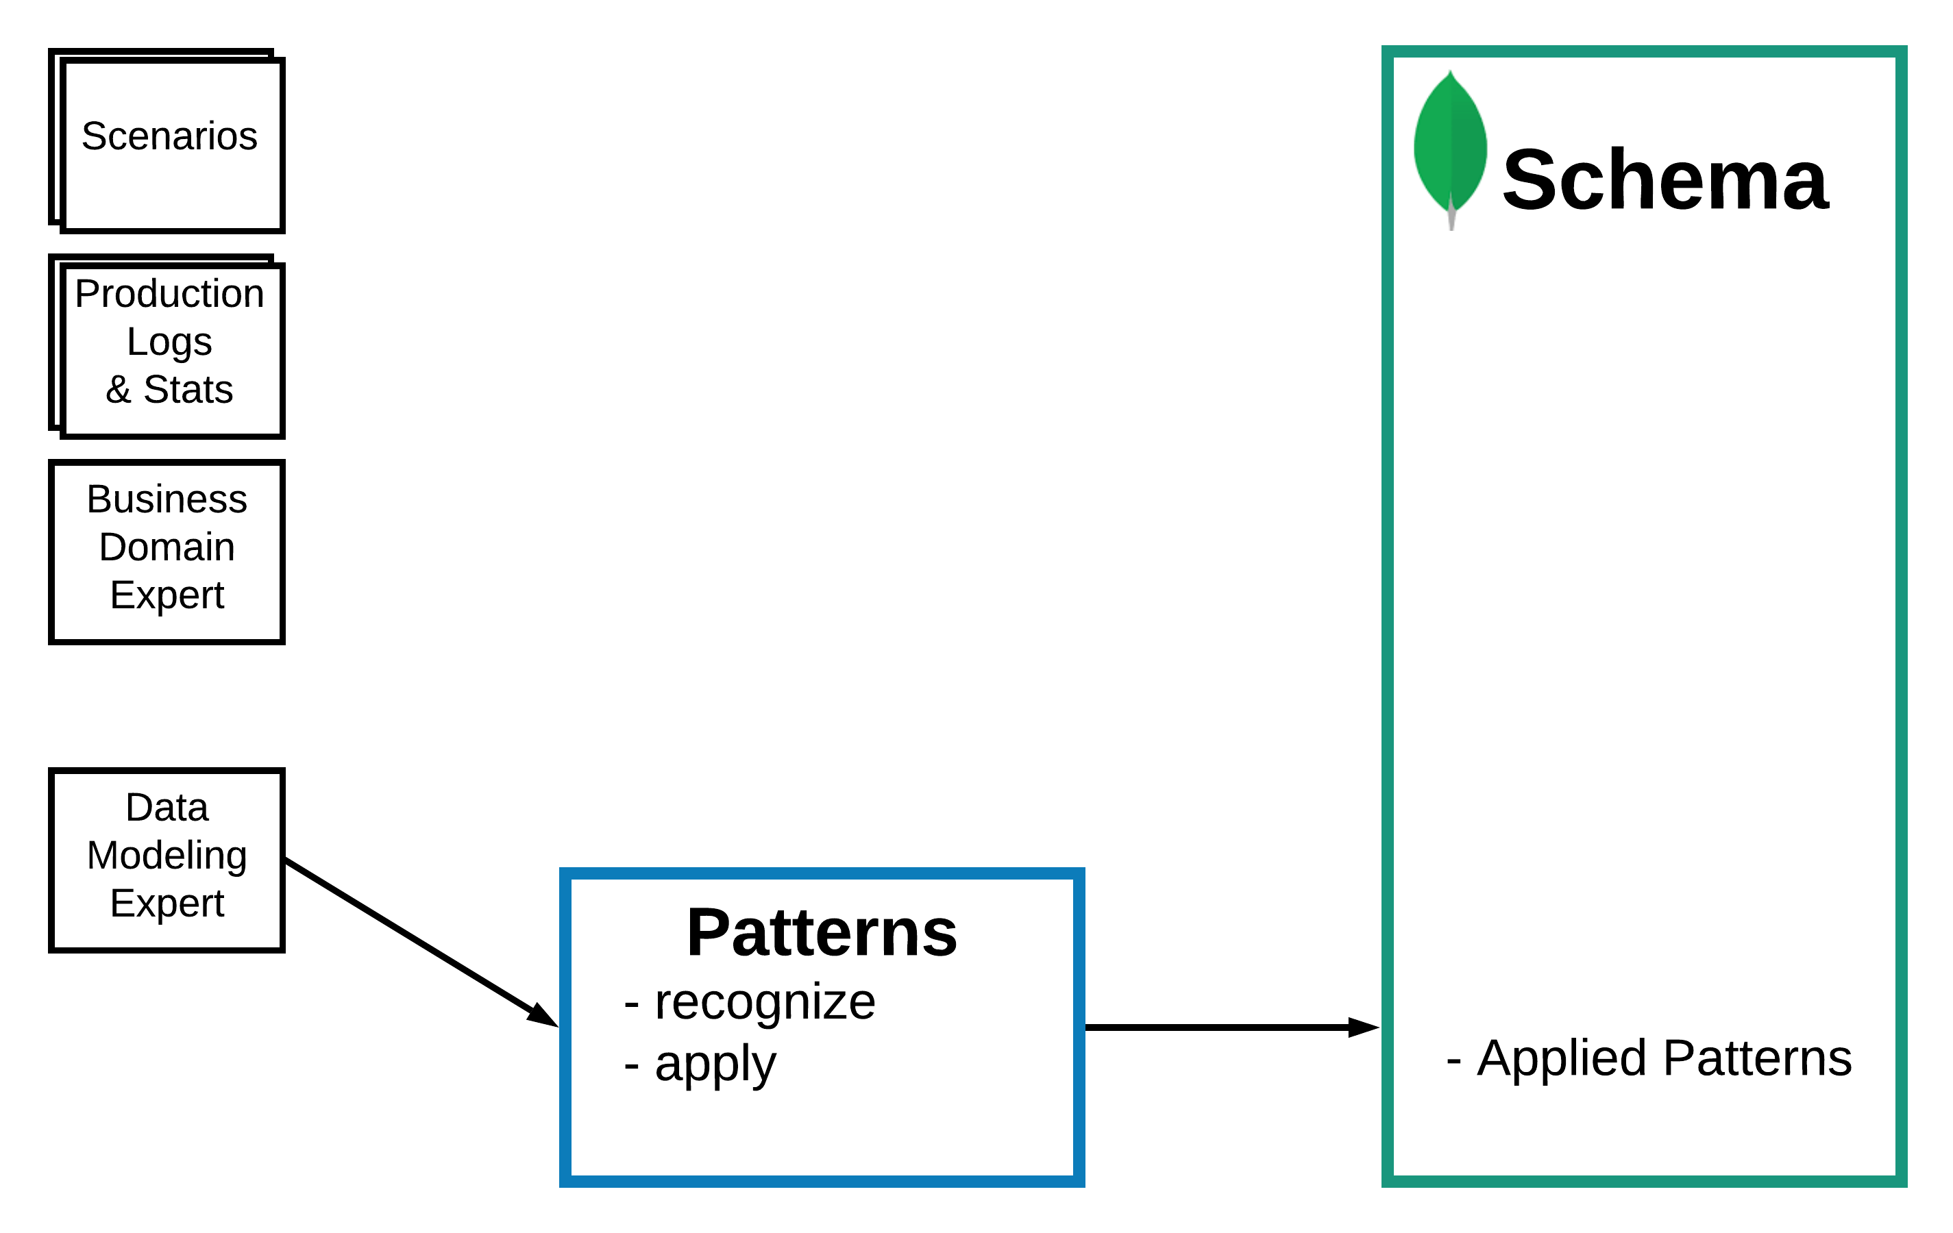
Methodology
Describe the Workload
Identify and Model the Relationships
Apply Patterns

Slide 61
Patterns
Recognize the need and when to apply Schema Design Patterns

Slide 62
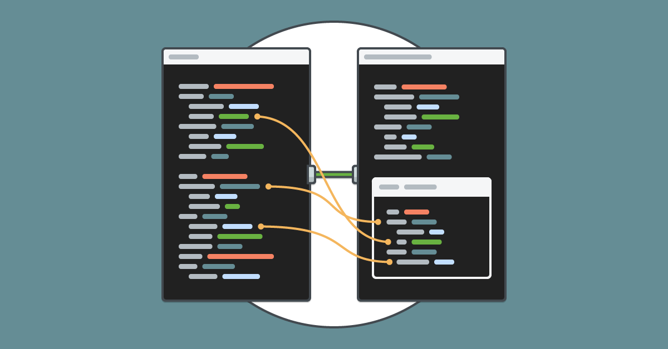
Schema Design Patterns Resources
Advanced Schema Design Patterns, Daniel Coupal
MongoDB World 2017
Blogs on Patterns, Ken Alger & Daniel Coupal
https://www.mongodb.com/blog/post/building-with-patterns-a-summary
MongoDB University: M320 – Data Modeling
https://university.mongodb.com/courses/M320/about

Slide 63
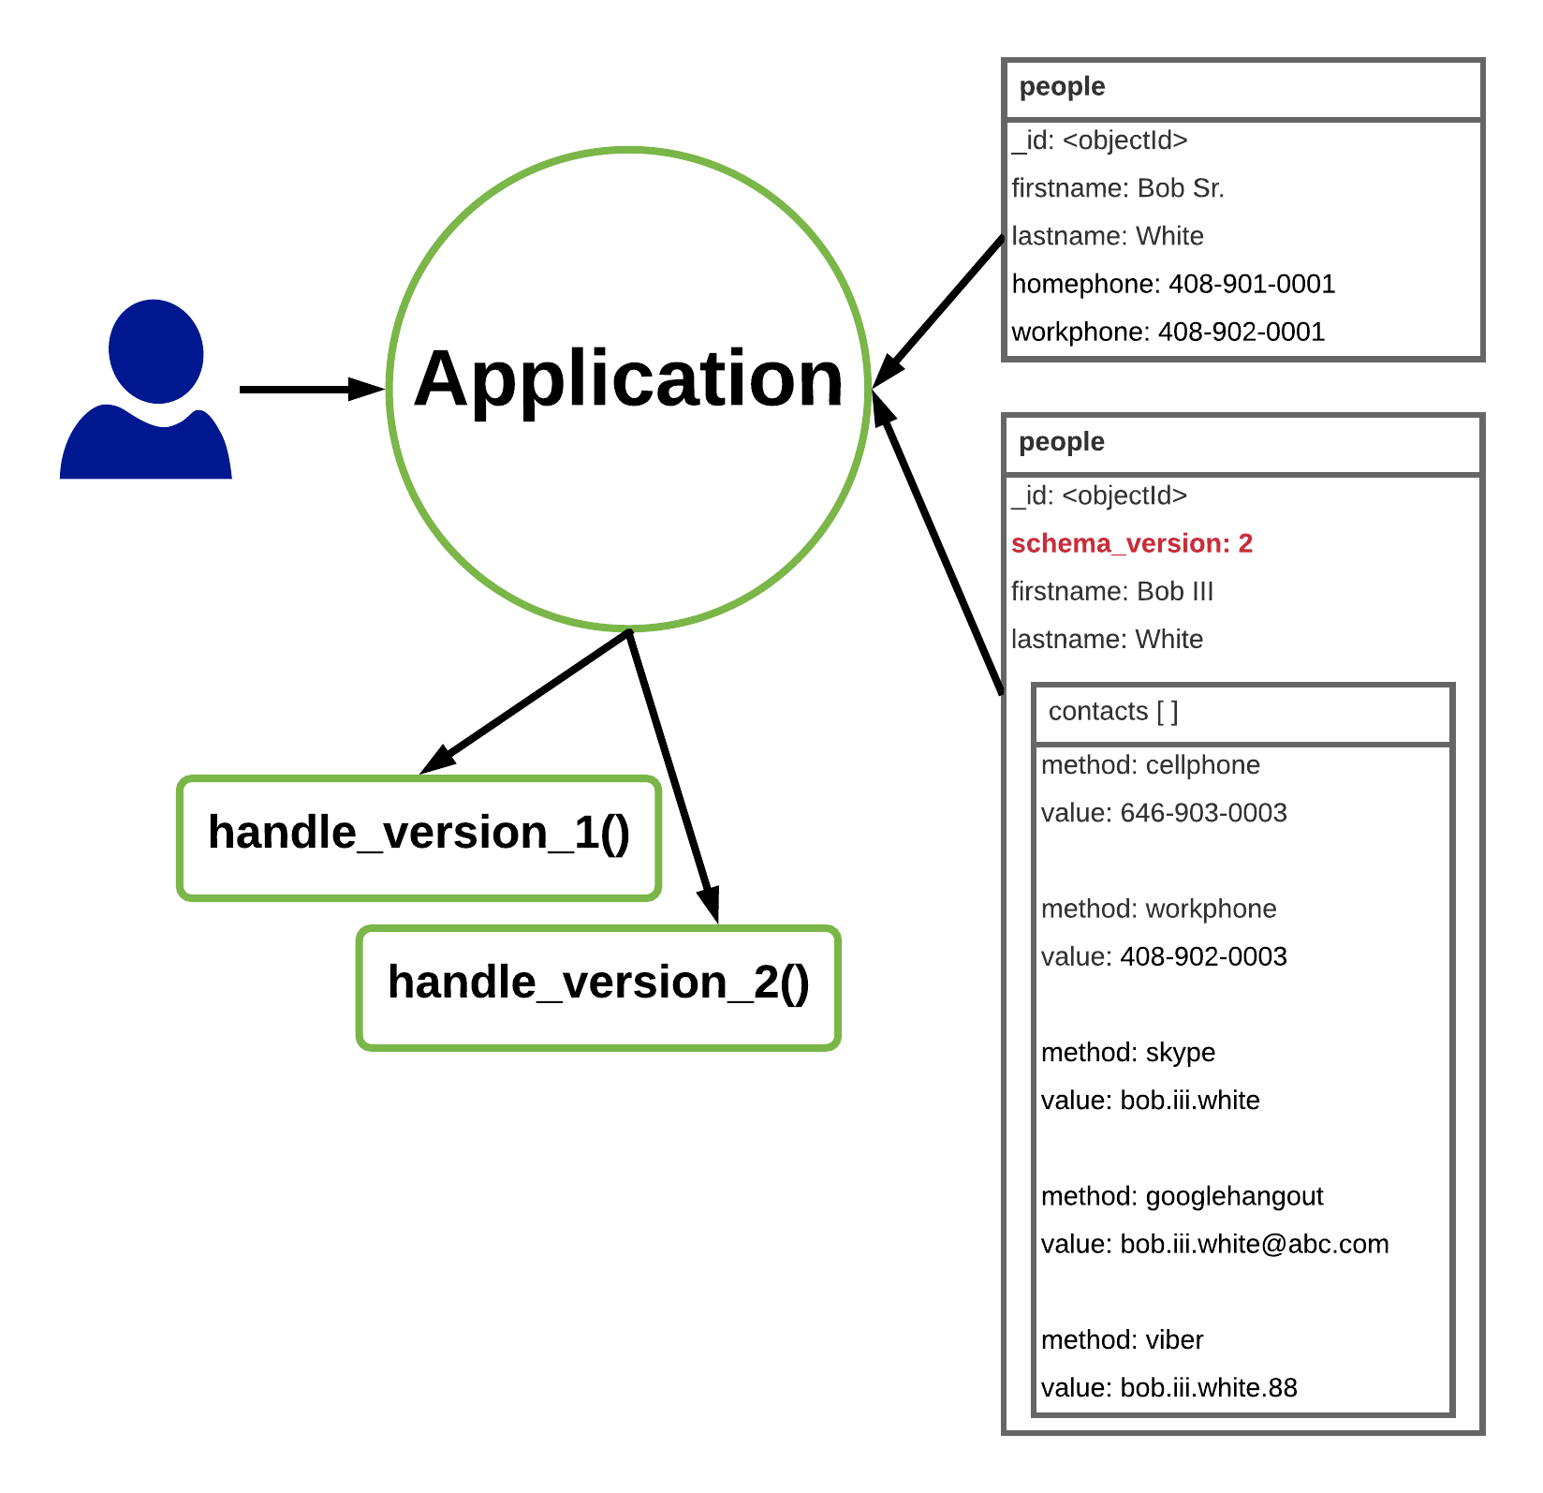
Schema Versioning

Slide 64
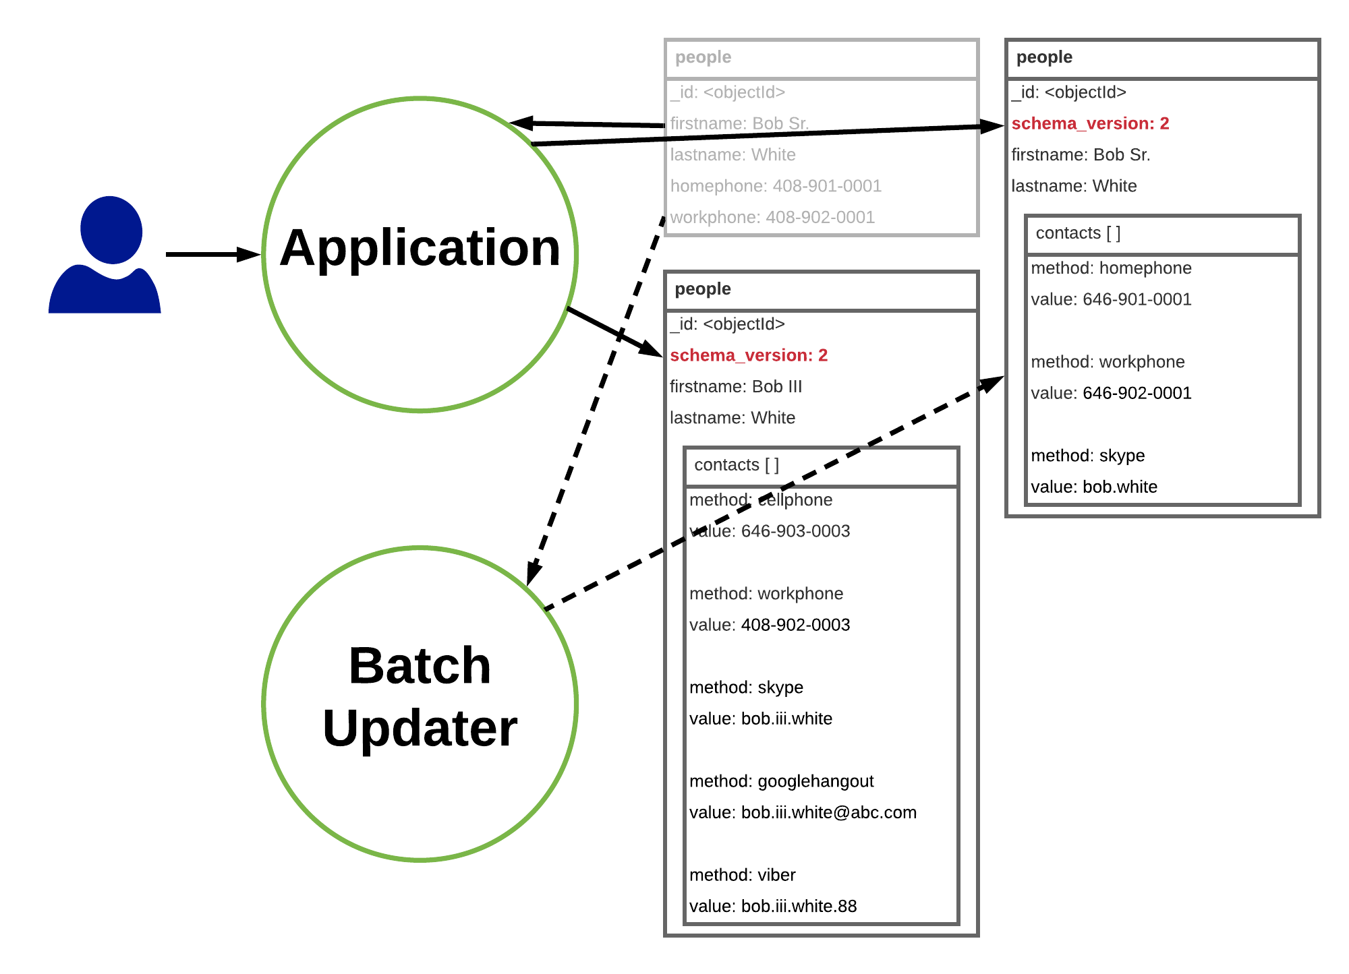
Schema Versioning

Slide 65
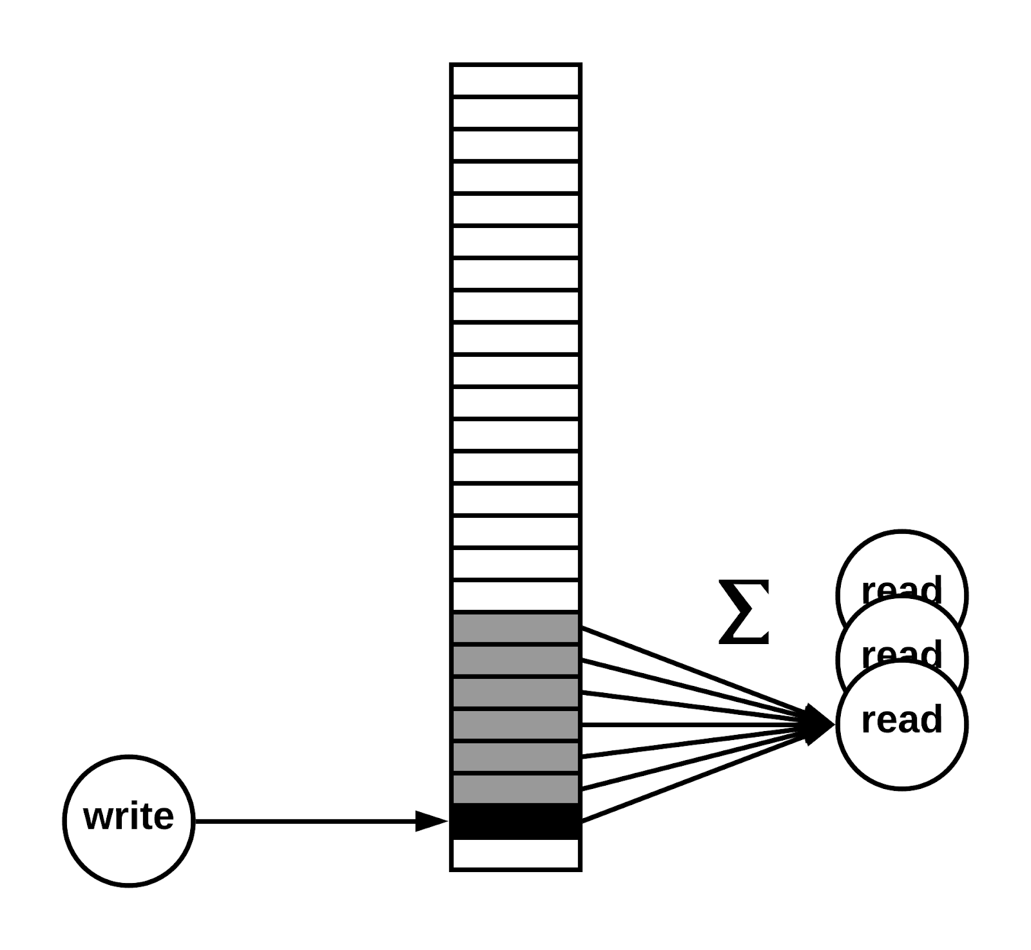
Computed Pattern

Slide 66
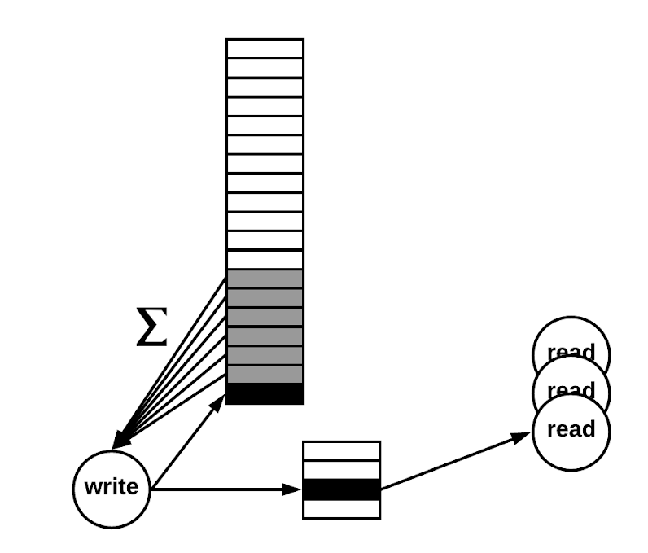
Computed Pattern

Slide 67
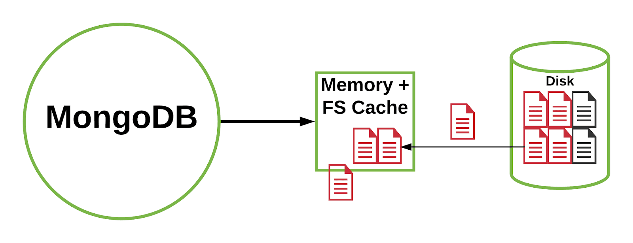
Subset Pattern

Slide 68
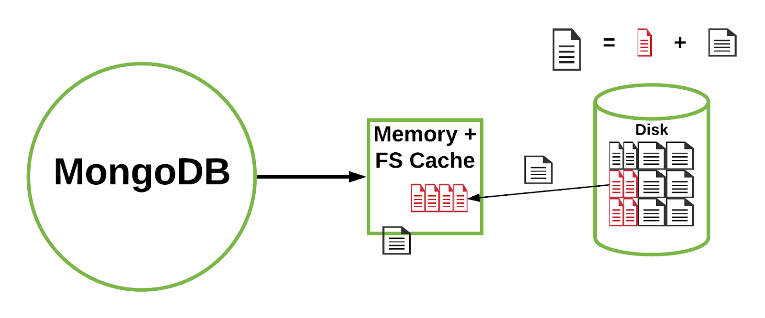
Subset Pattern

Slide 69
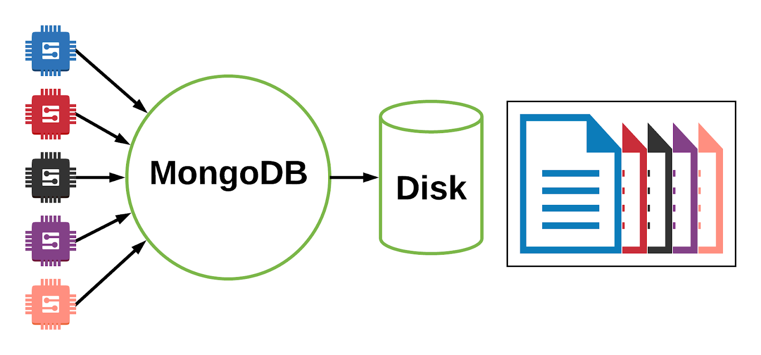
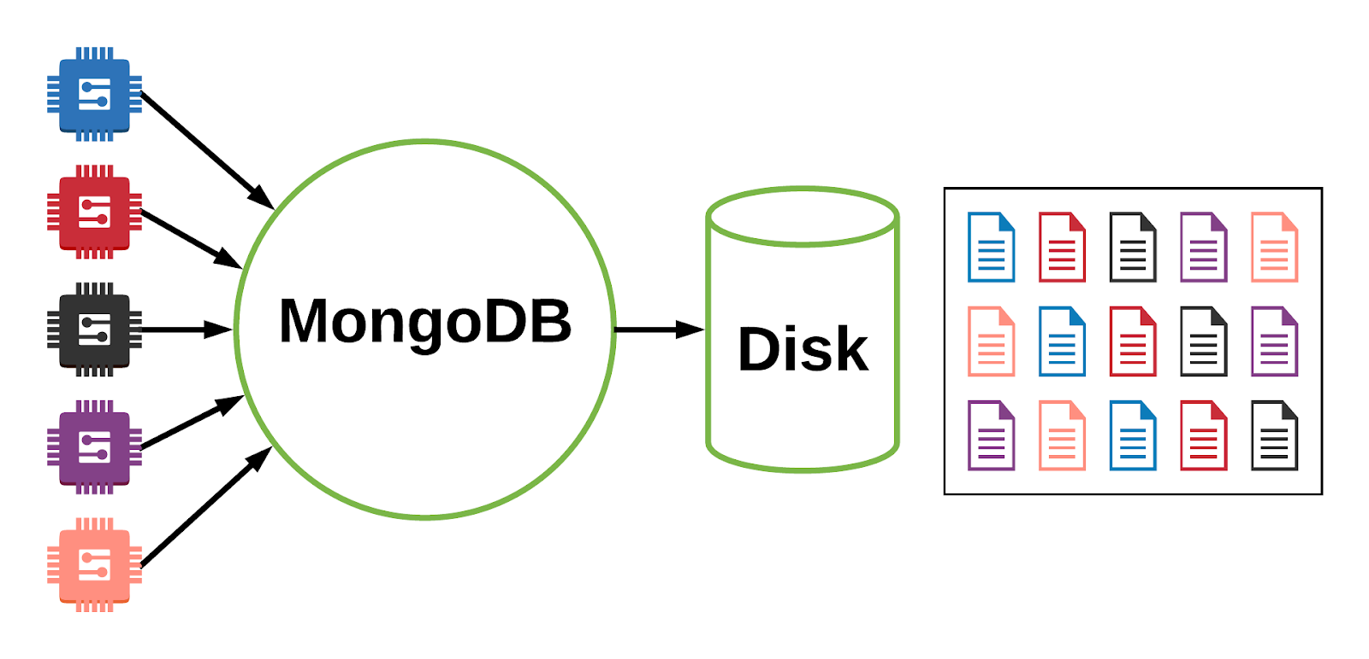
Bucket Pattern

Slide 70
Bucket Pattern
Bucket per Day
Bucket per Hour
{ "device_id": 000123456, "type": "2A", "date": ISODate("2018-03-02"), "temp": [ [ 20.0, 20.1, 20.2, ... ], [ 22.1, 22.1, 22.0, ... ], ... ] }
{ "device_id": 000123456, "type": "2A", "date": ISODate("2018-03-03"), "temp": [ [ 20.1, 20.2, 20.3, ... ], [ 22.4, 22.4, 22.3, ... ], ... ] }
{ "device_id": 000123456, "type": "2A", "date": ISODate("2018-03-02T13"), "temp": { 1: 20.0, 2: 20.1, 3: 20.2, ... } }
{ "device_id": 000123456, "type": "2A", "date": ISODate("2018-03-02T14"), "temp": { 1: 22.1, 2: 22.1, 3: 22.0, ... } }

Slide 71
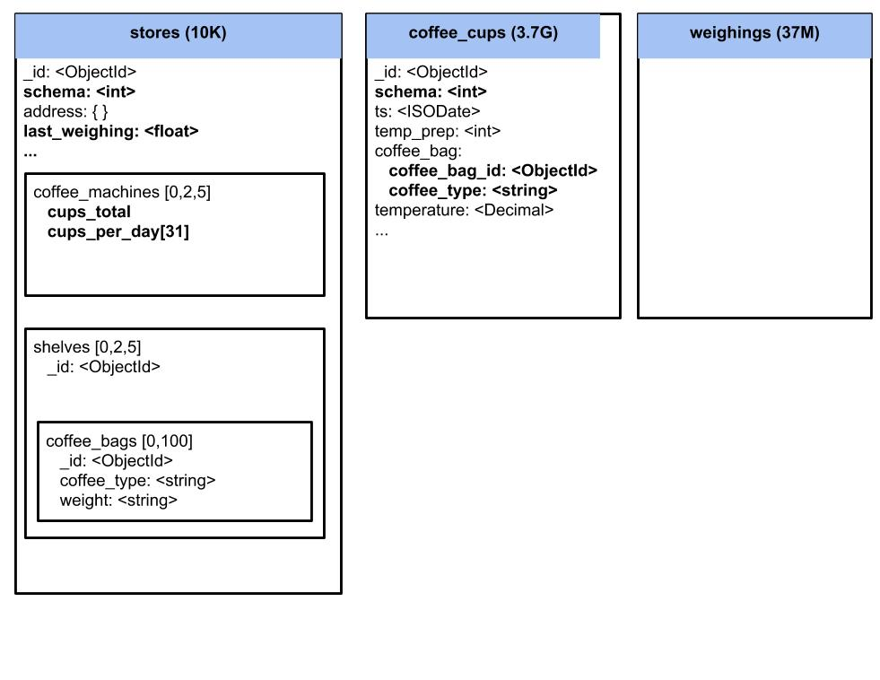
Solution with Patterns
Schema Versioning
Computed
Subset
Bucket

Slide 72
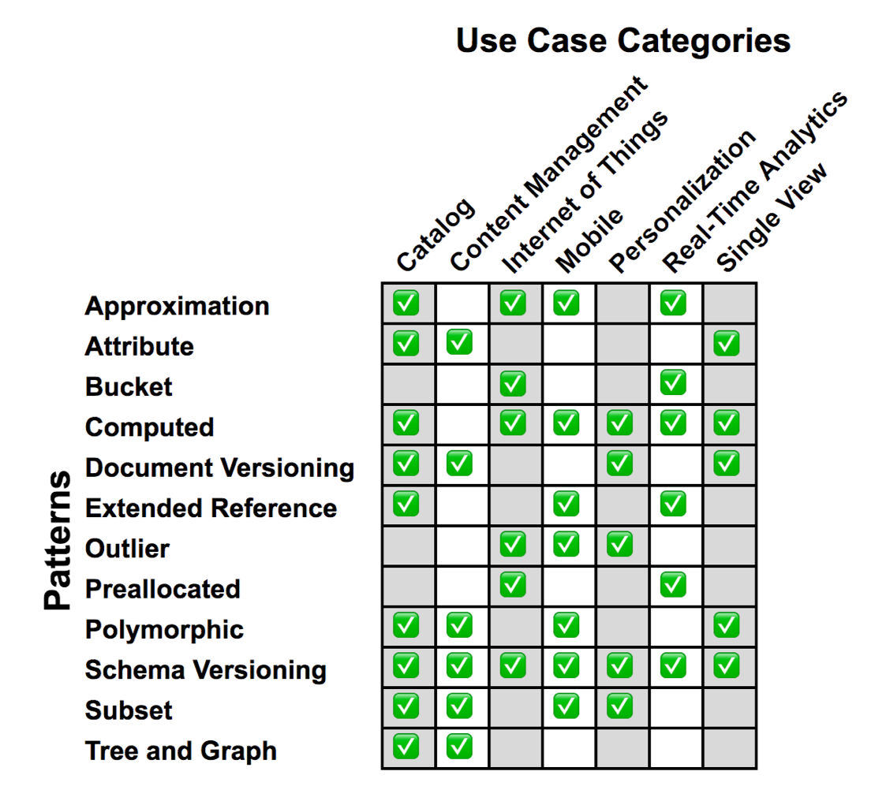
Data Modeling Patterns Use Cases
https://university.mongodb.com/courses/M320/about

Slide 73
Conclusion

Slide 74
Takeaways from the Presentation
Document vs Tabular
Methodology
Patterns
Recognize the differences
Summarize the steps when modeling for MongoDB
Recognize when to apply

Slide 75
Takeaways from the Presentation
Document vs Tabular
Methodology
Patterns
Recognize the differences
Summarize the steps when modeling for MongoDB
Recognize when to apply

Slide 76
Takeaways from the Presentation
Document vs Tabular
Methodology
Patterns
Recognize the differences
Summarize the steps when modeling for MongoDB
Recognize when to apply

Slide 77
Thank you for taking our FREE MongoDB classes at university.mongodb.com

Slide 78

Register Now! https://university.mongodb.com/courses/M320/about

Slide 79

A Complete Methodology of Data Modeling for MongoDB
https://www.surveymonkey.com/r/CZL87XD

Slide 81
Appendix A Schema Versioning Pattern

Slide 82

Nightmare: Alter Table

Slide 83

This is what your dreams should be when thinking about a schema upgrade !

Slide 84
Schema Revision
 | Relational | MongoDB
Versioned Unit | Schema | Document
Migration Procedure | Difficult | Easy
Service Uptime | Interrupted | No interruption
Rollback | Difficult to nightmare-ish | Easy

Slide 85
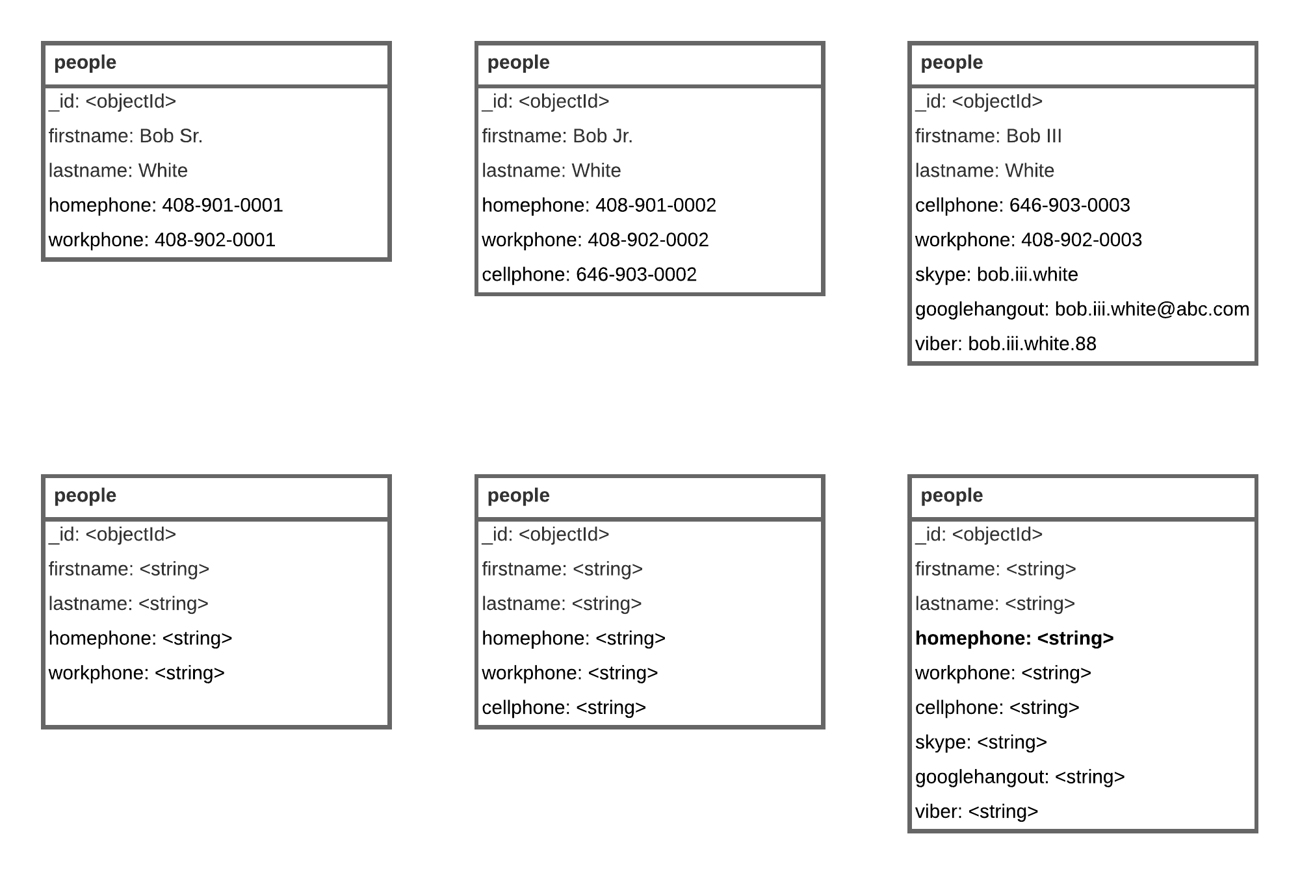

Slide 86
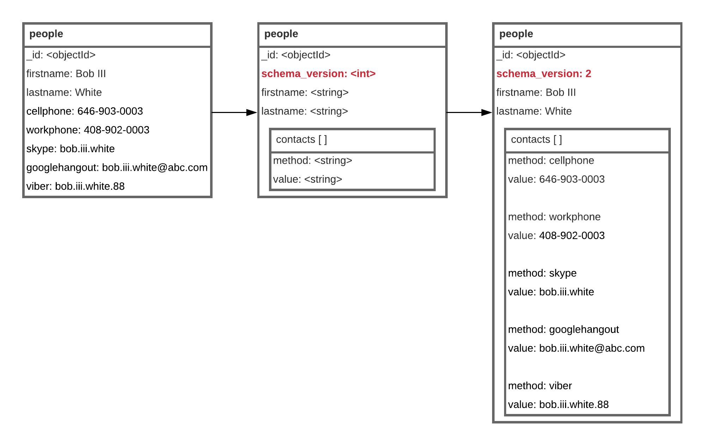

Slide 87
Application Lifecycle
Modify Application
Can read/process all versions of documents
Have different handler per version
Reshape the document before processing it
Update all Application servers
Install updated application
Remove old processes
Once migration completed
remove the code to process old versions.

Slide 88
Document Lifecycle
New Documents:
Application writes them in latest version
Existing Documents
) Use updates to documents
to transform to latest version
keep forever documents that never need an update
) or transform all documents in batch
no worry even if process takes days

Slide 89
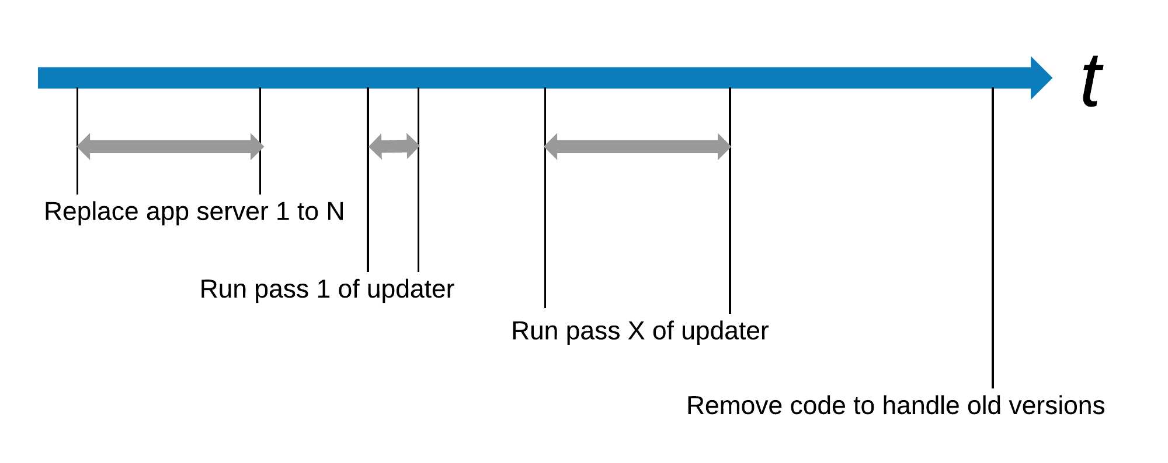
Timeline of the migration

Slide 90
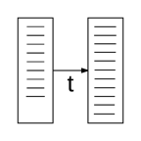
Schema Versioning Pattern
Problem
Solution
Avoid downtime while doing schema upgrades
Upgrading all documents can take hours, days or even weeks when dealing with big data
Don't want to update all documents
Each document gets a "schema_version" field
Application can handle all versions
Choose your strategy to migrate the documents
Use Cases Examples
Benefits and Trade-Offs
Every application that use a database, deployed in production and heavily used.
System with a lot of legacy data
No downtime needed
Feel in control of the migration
Less future technical debt
May need 2 indexes for same field while in migration period

Slide 91
Appendix B Computed Pattern

Slide 92

Mathematical Operations

Slide 93

Mathematical Operations

Slide 94
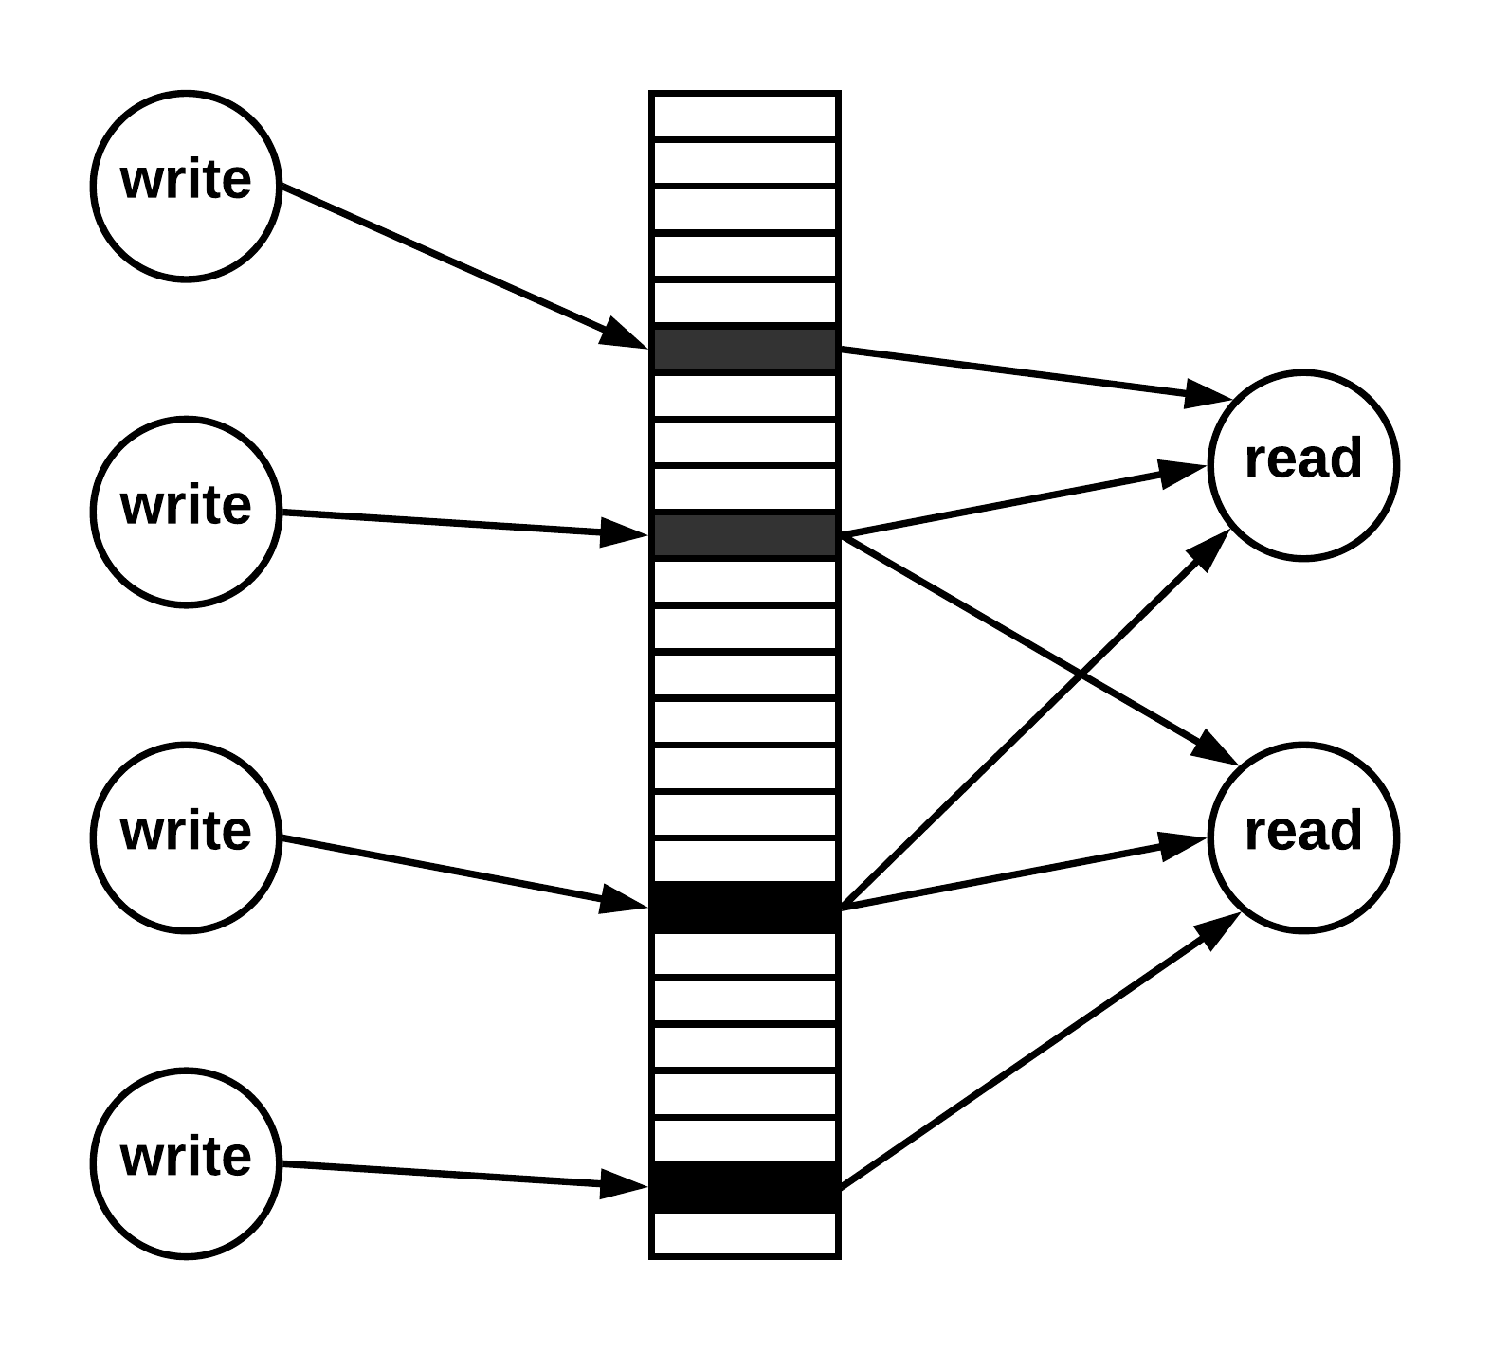
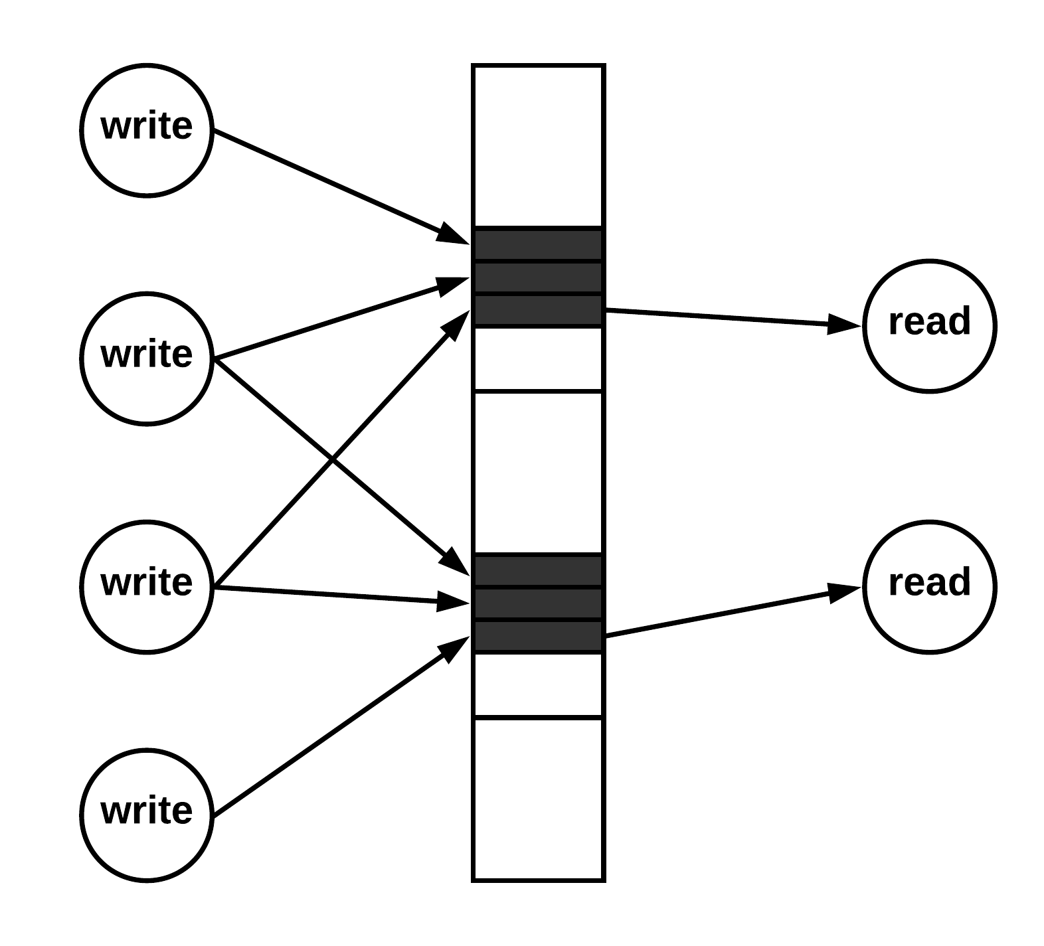
"Fan Out" Operations

Slide 95
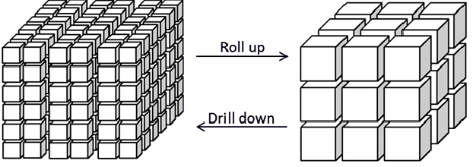
"Roll Up" Operations

Slide 96
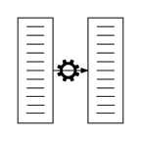
Computed Pattern
Problem
Solution
Costly computation or manipulation of data
Executed frequently on the same data, producing the same result
Perform the operation and store the result in the appropriate document and collection
If need to redo the operations, keep the source of them
Use Cases Examples
Benefits and Trade-Offs
Internet Of Things (IOT)
Event Sourcing
Time Series Data
Frequent Aggregation Framework queries
Read queries are faster
Saving on resources like CPU and Disk
May be difficult to identify the need
Avoid applying or overusing it unless needed

Slide 97
Thank you

